Slide 1
Finishing up Fid’Lin
Team 2
Jakob Beckleheimer, Dylan Brownell, Tanner Groll,
Derek Pendleton, & Phil Snider

Slide 2
This iteration we…
Cleaned up the brain tuning function
Created a sequence and state diagram
Created a lessons learned document
Cleaned up the UI
Brushed up on our documents and diagrams
Reduced Inefficient Code

Slide 3
C# and Xamarin Forms
Not your average .NET project.
Plug-ins necessary to do many normal tasks.
System specific tasks such as timers
Large number of additional libraries to support mobile development.

Slide 4
Tuning
Brain Tuning
Push button system
Stop button for convenience
Only one sound at a time

Slide 5
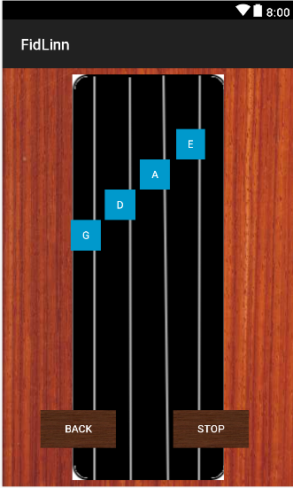
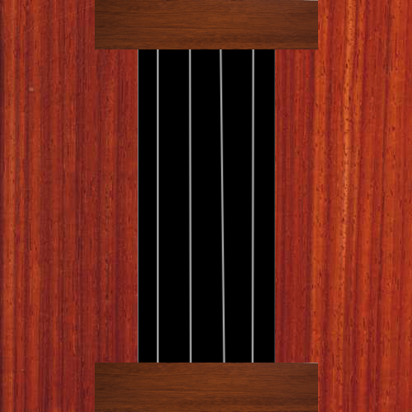
Tuning UI

Slide 6
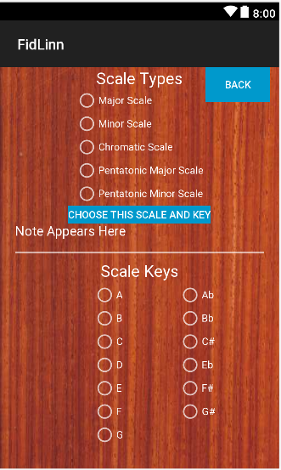
Scales UI

Slide 7
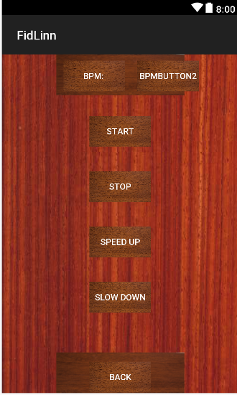
Metronome UI

Slide 8
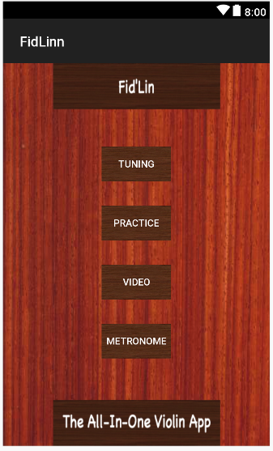
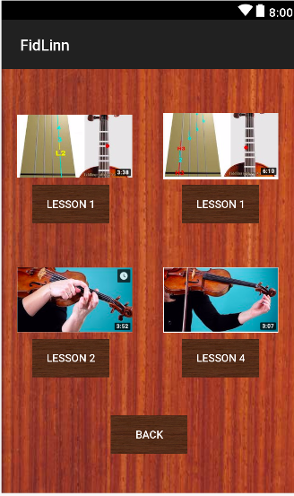
Menu UI / Video Ui

Slide 9
Improvements from Last semester (Software engineering)
Prioritized documentation more-so
Constant communication throughout the semester
Remote Desktop
Team Coding
Have a functional product
Didn’t get (too) behind

Slide 10
What we could have done better as a team
Should have gotten a lot more code completed during Sprint 2 than we did.
Better game plan to take care of all functional requirements
Making sure things aren’t getting completed last minute
Time management

Slide 11
What we have learned from this course
The more communication between the team, the better.
The earlier things get completed, the better.
Procrastination is not your friend.

